Slide 1
Benchmarking Employment Services’ Contribution to the Implementation of the Youth Guarantee
PARES Project Final Conference
Ismeri Europa Promo PA
Rome, 13/05/2016

Slide 2
Objectives of the project
Youth Guarantee:
“Ensure that all young people under 25 get a good-quality offer (employment, apprenticeship, traineeship or continued education) within 4 months of them leaving education or becoming unemployed”
2015 Youth Service Package (YSP): within 3 months after registering unemployed:
Assessment of employability
Development of individual employment action plans and prescription of measures and activites aimed at increasing employability
Job offer or inclusion in some of the ALMP measures

Slide 3
The project ‘Benchmarking the role of PES...’
Objectives:
Identifying the common PES’ fields of activity in the implementation of the YG;
Comparing the extent to which PES have recourse to partnerships with other public, private and third sector bodies
Identifying the success factors and determinants of poor performances
Finding best practices and drawing lessons which are transferable
Disseminating the results of the study and fostering mutual learning processes.
Methodology:
Desk analysis (YG plans, monitoring documents, evaluation report, etc.)
National case studies: questionnaire, focus group and interview with national Authorities and Public Employment Services : Pôle Emploi (France), PES (Hungary), PES (Italy) and National Employment Service - NES (Serbia)
Statistics on participants, timing and services/mesures provided
Comparative analysis of PES’ performence , combining qualitative information and statistics on monitoring data (avilable only for France and Italy)

Slide 4
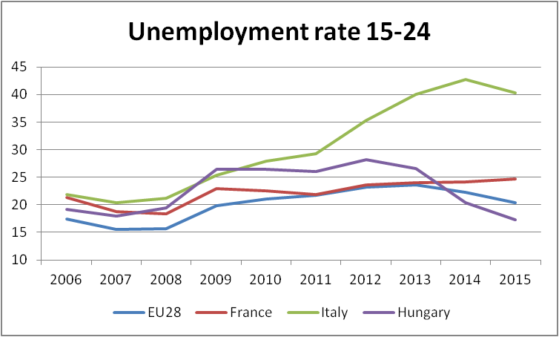
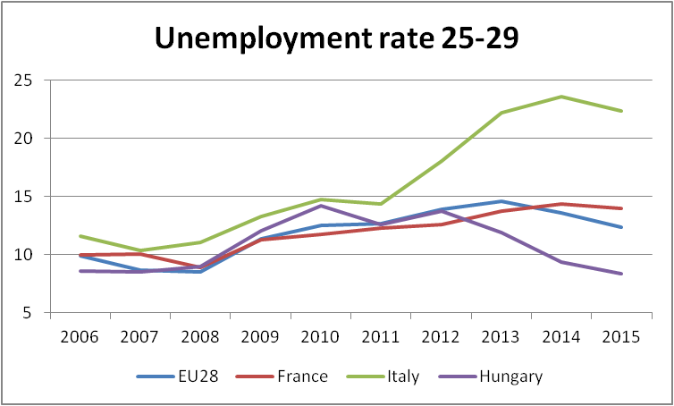
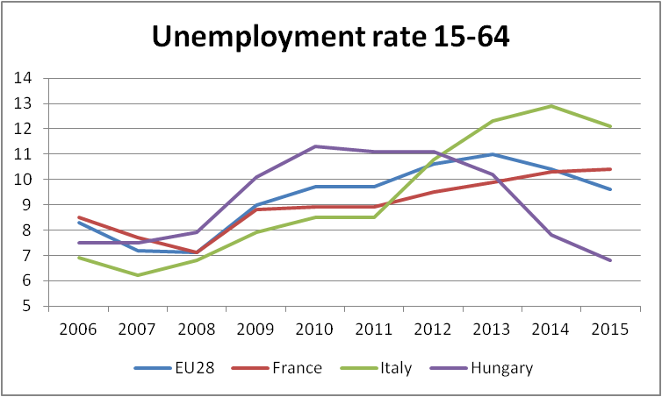
General labour market conditions
Country peculiarities
France: Disadvantaged urban areas
Italy: High regional disparities
Hungary: High regional disparities
Serbia: general low offer of work

Slide 5
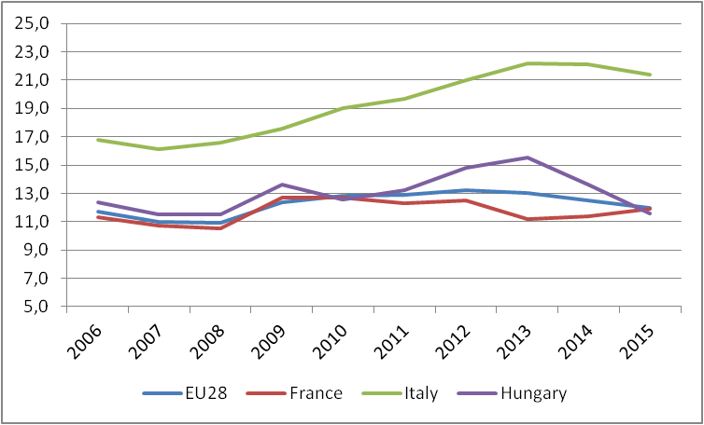
Trend of NEET 15-24

Slide 6
Governance of the national YG schemes
 | Coordination | Implementation | Partners | Monitoring | Target
FR | Ministry of Labour | Pôle Emploie | Mission Locales Minsitry of Education Private providers | PES centralise information | NEETs 15-25 year olds
HU | Ministry of national Economy | NES with Education Ministry | Minsitry of Education NGOs Counties | Survey
IT | Ministry of Labour | Regions with PES | Economic and social Partners Private providers Employers | PES centralise information | NEETs 15-29 year olds
SR | Ministry |  | Local Governments Economic and social Partners | PES centralise information | All youngsters

Slide 7
Role of PES and aims of the partnerships
 | Role of PES | Role of main patners | Type of main partnerships
FR | Outreach, register, orient, support and follow-up | Provision measures but to a limitetd extent | Institutional cooepration
HU | Outreach, register and orient
IT | Outreach, register and orient | Outreach, register and orient Provision of most measures | Partenrship for communication and inforamtion Divion of tasks regarding take up and measures
SR | Register and orient | Provision measures | Institutional cooepration

Slide 8
Capacity of PES and preparation to the YG
 | Magnitude of NEET | Initial PES capacity | Preparation to the YG | State of the YG
France | In line with EU average | High investments in active policies Employment centres as one-stop-shop High institutional capacity Guarantee schemes already in force before the start of the YG | Additional specialized staff (788 counsellors) Reinforcement of existing services Focus on the most vulnerable NEETs/Regions | At operating speed
Hungary | In line with EU average | Decentralized system (Counties) | Additional specialised human resources (mentor network) | Partial
Italy | High, especially for the 25-29 year olds | Low investments in active policies and in PES Decentralized system (Regions) Shortages of staff Lack of specialized competences Bureaucratic approach | New multi-level governance Training campaigns for operators National digital platform Involvement of private providers | Advanced
Serbia | n.a. | Centralized system Shortage of budget | Priority of PES established annually Constant training of staff | At operating speed

Slide 9
Outreach to NEETs: implmentation
Significant effort for communication and information, for instance Italy at national level and other Partners more at local level
Partnerships:
France, strong institutional partnerships with other offices services for education/inclusion of the Ministry of Education
Formal and informal partnership with social and economic stakeholder above all in Serbia and Hungary and to a lesser extent in Italy
Italy, no relevant partnership with education at local level, weak effort on preventive measures
Weak monitoring above all in Hungary, except Italy

Slide 10
Outreach to NEETs: Results
Relevance of the amount of youngster registered with respect to the magnitude of NEETs
Quick increase of the youngsters enrolled:
Italy 1,04 million (April 2016), but less effectiveness with respect to the most vulnerable NEET
France 736 thousand between July 2013 – December 2015 and exited within 2015 (reached also sub targets)
Success also in Serbia, but no quantitative data
Hungary no data

Slide 11
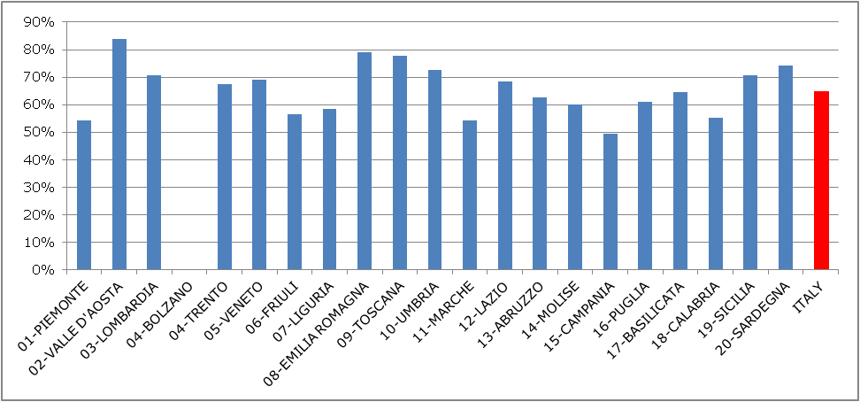
Provision of YG services: results 1
Now ensured the time-lag of 4 months except Hungary and including Serbia
Italy - Share of the registered NEETs (15-29 year olds) assisted

Slide 12
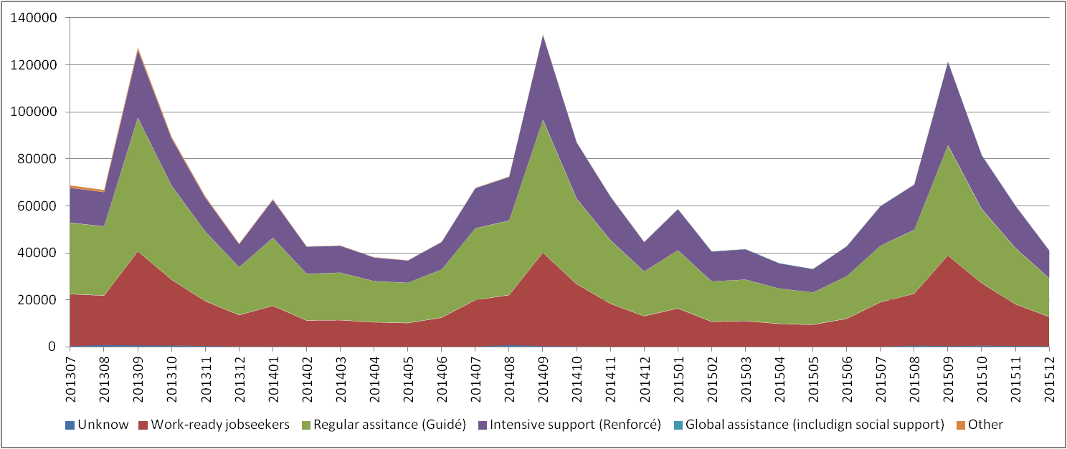
Provision of YG services: results 2
FRANCE - Number of NEETs (15-25 year olds) taken up per months of entering the YG and services offered by PES (Percours du domandei) in the period July 2013 – December 2015

Slide 13
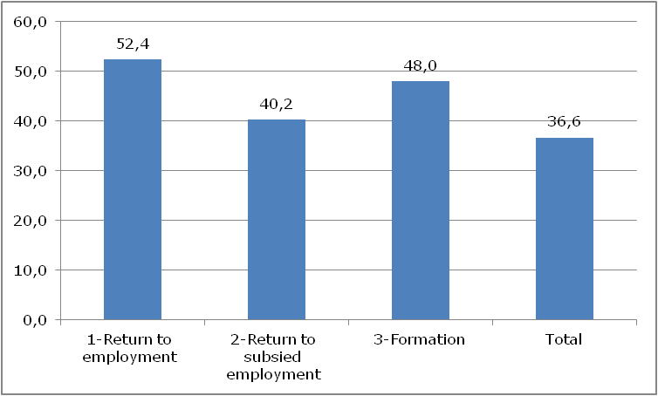
Delivery of the Measures: results France
Schemes of preparatory services |  | Status after 18 months |  |  |  |  | Total
 |  | 1-Return to employment | 2-Return to subsided employment | 3-Training | 4-Unemployed | 5-Lost track
Unknown |  | 1.173 | 84 | 806 | 354 | 2.107 | 4.524
A. Work-ready jobseekers (Suvi) |  | 153.659 | 2.804 | 10.927 | 10.892 | 35.044 | 213.326
B. Regular assitance (Guidé) |  | 184.743 | 5.663 | 24.402 | 27.016 | 72.142 | 313.966
C. Intensive support (Renforcé) |  | 110.237 | 5.663 | 21.911 | 19.210 | 43.377 | 200.398
D. Global assistance (including social support) |  | 486 | 66 | 88 | 193 | 83 | 916
E. Other |  | 438 | 30 | 105 | 527 | 1.923 | 3.023
Total |  | 450.736 | 14.310 | 58.239 | 58.192 | 154.676 | 736.153
% for columns |  | 61,2% | 1,9% | 7,9% | 7,9% | 21,0% | 100%
The registered taken in charge by PES within 4 months

Slide 14
Delivery of the Measures: results
“4 months” objectives only partially reached by EU Partners
Serbia: many assisted and ensured 3 months time-lag but problems concerning budget availability (e.g. Self-employment)
Italy: 223,846 participants to the measure

Slide 15
Delivery of the measures: implementation
All PES follow a standardised process and profiling
Italy: new delivery model (at least 3 public-private delivery model), higher cooperation PES/Private agencies
France: personalized approach (different intensity of service, good ratio between human resources and customers, additional expertises based on the institutional partnership with the Mission Locales)
Serbia good model of profiling articulated in various steps
Italy and Hungary: weak link between profiling/personalized approach and chose of the measures (e.g. IT huge amount of traineeships: 135,895 on 223,846 )

Slide 16
Good practices identified
Profiling – Methods followed by (France and Serbia)
Informative system and monitoring – ‘National digital platform’ (Italy)
Communication – ‘Employment Caravan’ (Serbia)
Employment services:
Collective support inspired to ‘Club Junes’ (France)
Mentor network (Hungary)

